Slide 1


Round 1
The Year That Was....

Slide 2

Question 1 - December
In December 2014 Sony suffered a serious breach of their IT systems. In the emails that were hacked, who was described by film executives as ‘a minimally talented spoilt brat'?
A. Angelina Jolie

Slide 3

Question 2 - January
With whom was Sam Smith forced to share the writing credits for his Grammy-nominated single ‘Stay With Me’?
A. Tom Petty (similarities with his 1989 hit ‘I Won’t Back Down’).

Slide 4

Question 3 - February
Name the controversial film, directed by Sam Taylor-Johnson and starring the daughter of Melanie Griffith released in this month.
A. Fifty Shades of Grey.

Slide 5

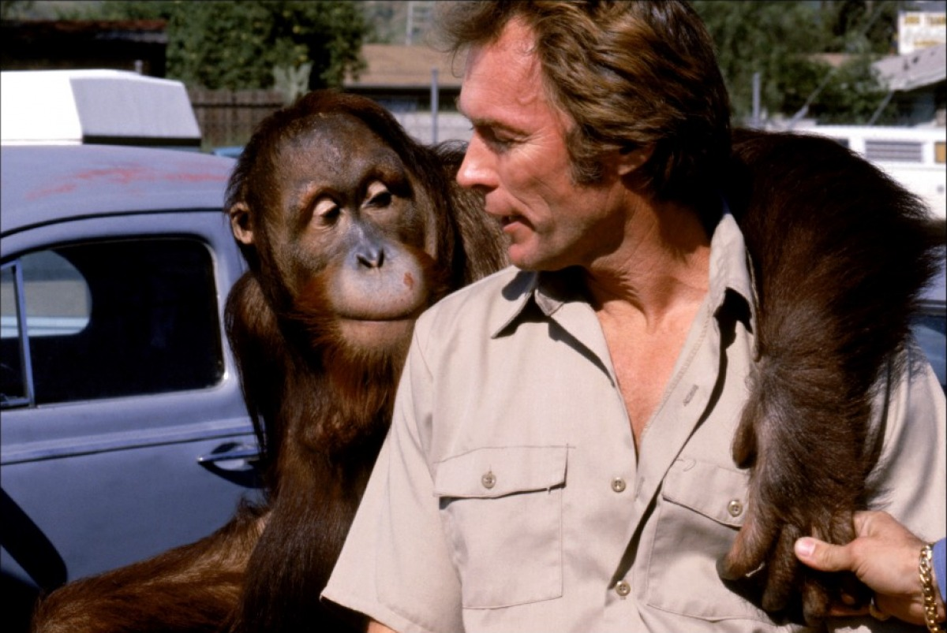
Question 4 - March
Who did Oisin Tymon have a falling-out with this month?
A. Jeremy Clarkson (Jezza the Orangutan)

Slide 6

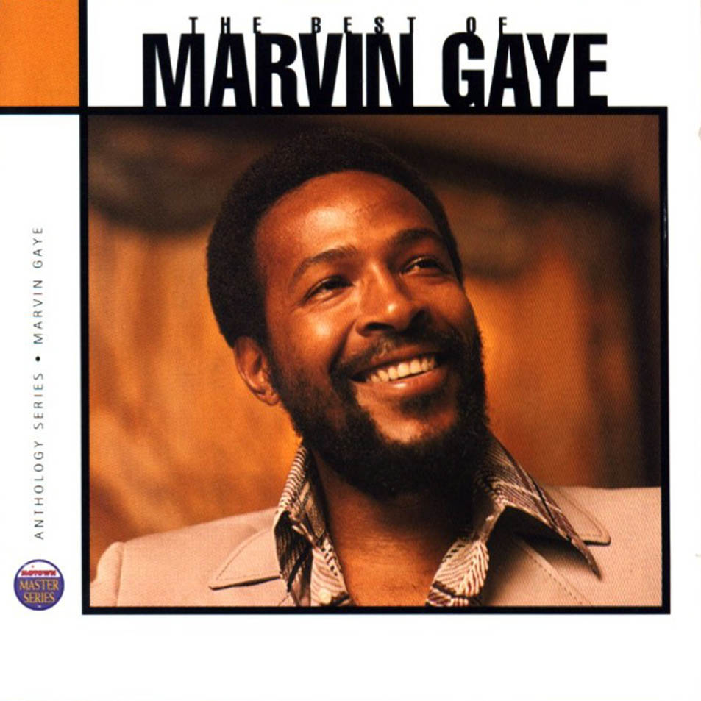
Question 5 - April
Giant pandas Xi Mei and Lu Lu broke the record for what?
A. The longest mating session ever recorded in captivity (lasting 18 minutes and three seconds!).

Slide 7
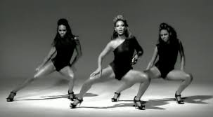
Question 6 - May
More than 60% of the Irish population said ‘Yes’ to what this month?
A. Amending the country's constitution to allow gay and lesbian couples to marry.

Slide 8
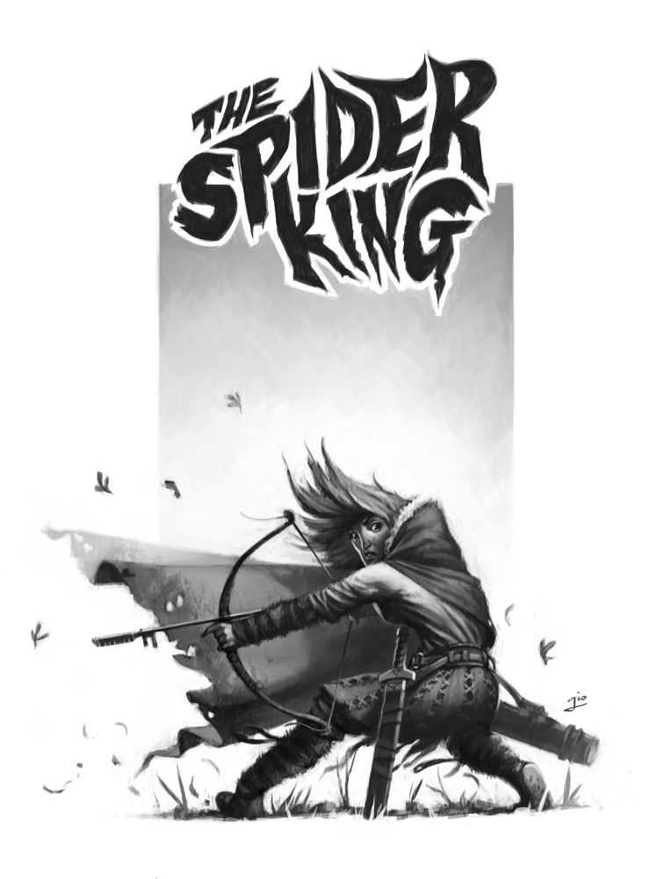


Question 7 - June
Name the author of the so-called ‘Black Spider Memos’.
A. Prince Charles

Slide 9
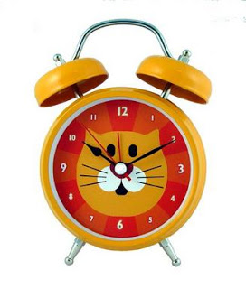

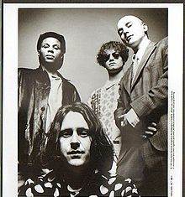
Question 8 - July
Which 89 year old author’s book entitled ‘Go Set a Watchman’ was published this month?
A. Harper Lee

Slide 10


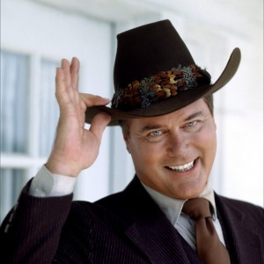
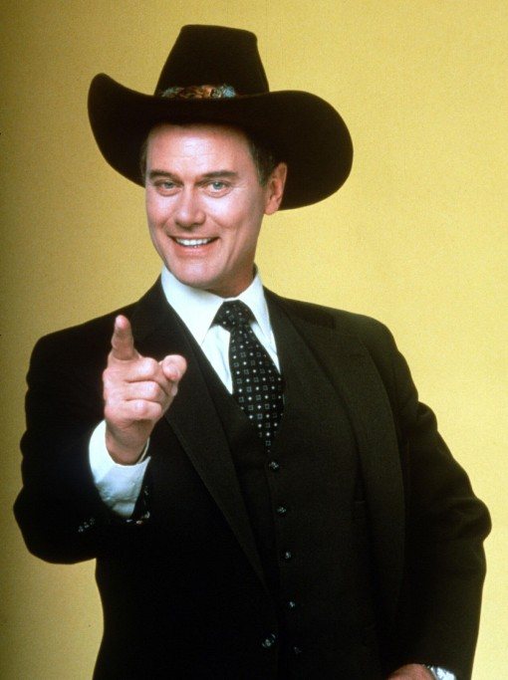
Question 9 - August
Who shot Cecil?
A. US dentist Walter Palmer.

Slide 11

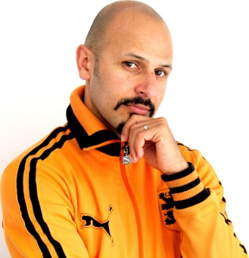
Question 10 - September
The new series of Downton Abbey caused a flood of complaints to ITV after it’s first episode. Why?
A. It was accused of ‘racism’ for casting a chambermaid who was blackmailing Lady Mary with a Scouse accent. Calm down, Calm down!

